Slide 1
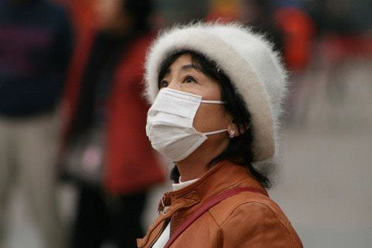
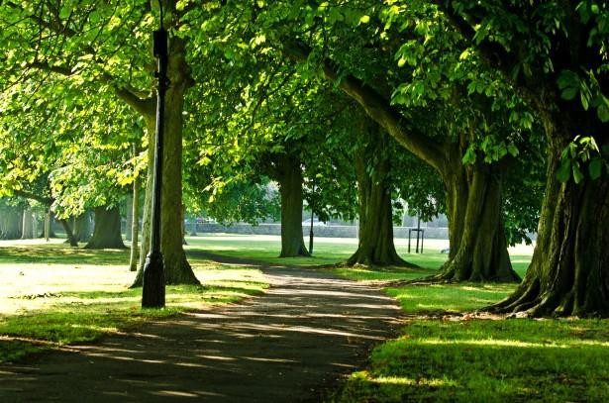
Developing the natural capital account
for air pollution removal by vegetation
Laurence Jones, Stefan Reis, Massimo Vieno, Eiko Nemitz, Rachel Beck, Edward Carnell, Mike Holland, Philip Cryle, Ian Dickie and others
eftec
Economics for the
Environment Consultancy
EMRC

Slide 2
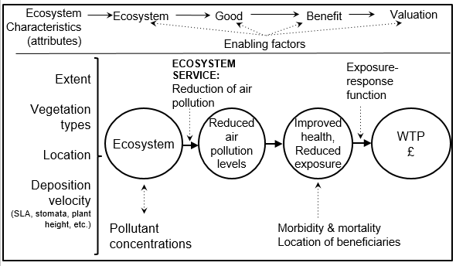
SEEA Natural Capital accounts
2

Slide 3
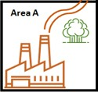



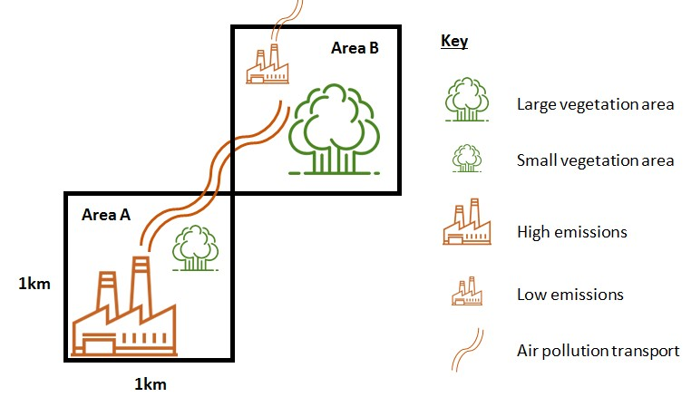

Spatial context of service and beneficiaries
3
Atmospheric transport:
Location of beneficiaries
Health damage function
Chemical and climate interactions
Area C
Key
Area
B
Area
A
3

Slide 4
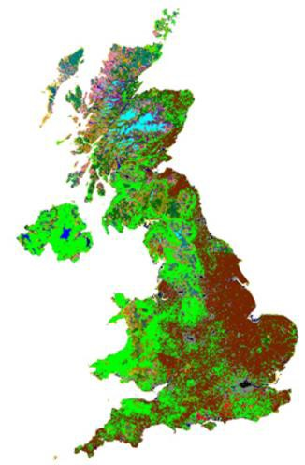
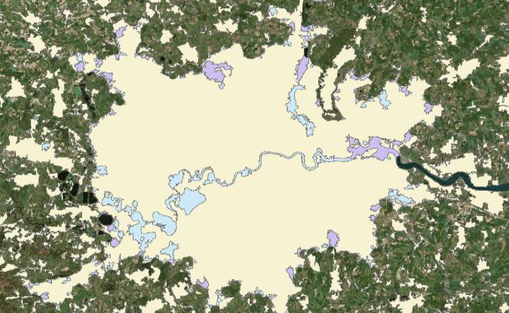
Overview of the approach taken
Physical account:
EMEP4UK atmospheric transport
model
Health and monetary account:
ALPHA RiskPoll model
Scenario approach
Separate UK & urban calculations
UK vegetation
(CEH Landcover Map)
New urban extent

Slide 5
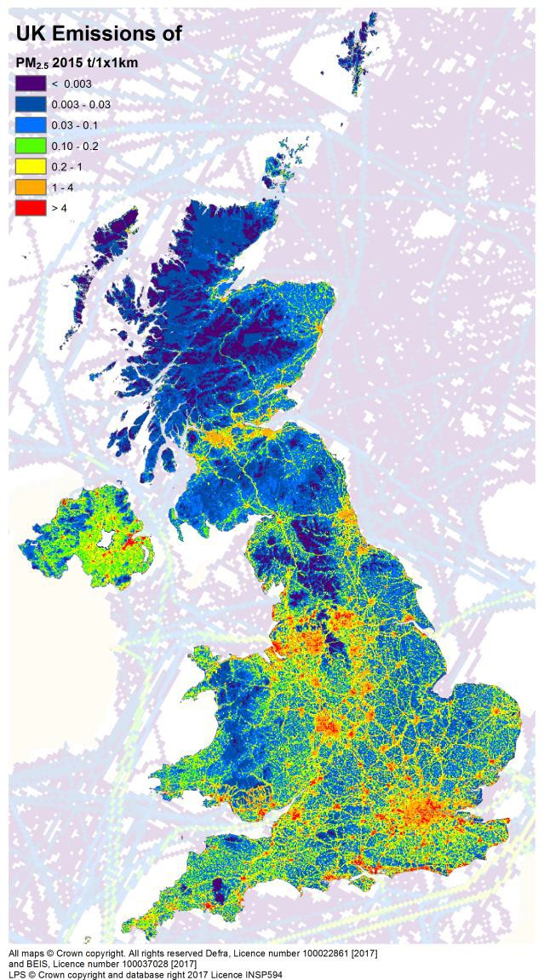
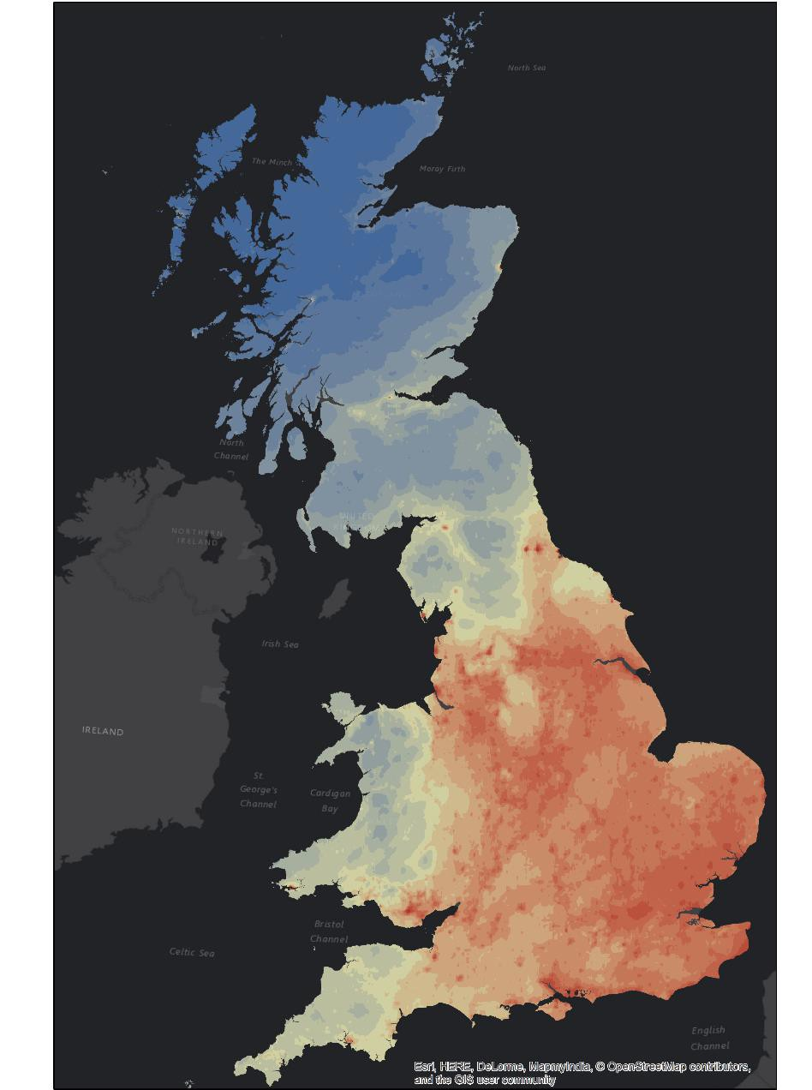
Atmospheric chemistry modelling
5
Physical account
Chemical interactions at 5 km x 5 km
(~1.5 x 2km also possible)
Vegetation cover at 25 metre resoluti
Hourly time step
Generates concentrations from emissions, including
Chemical & meteorological interactio
& Atmospheric transport
Five pollutants of interest: (PM_{2.5}, SO₂, NH₃, NO₂, O₃)
UK NAEI
on
ns
2015, concentrations of PM_{2.5}

Slide 6
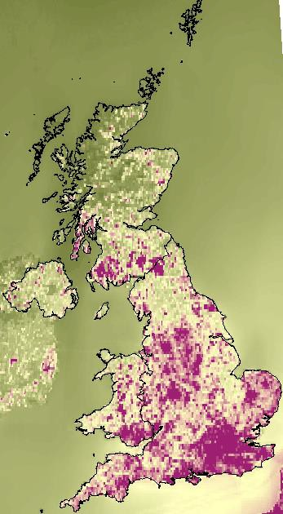
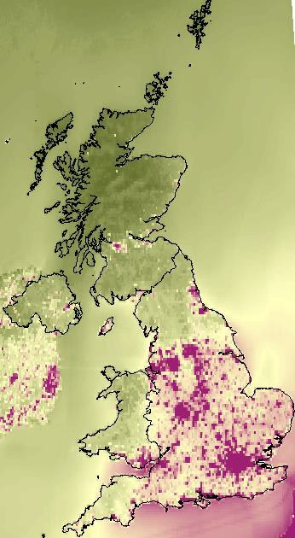
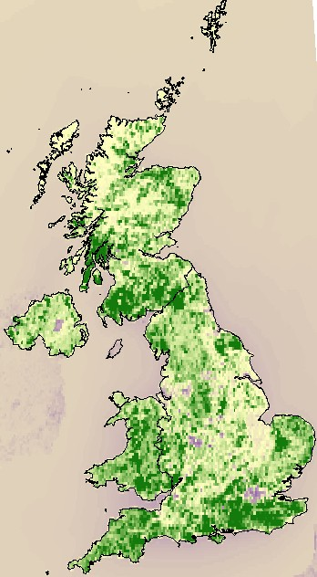
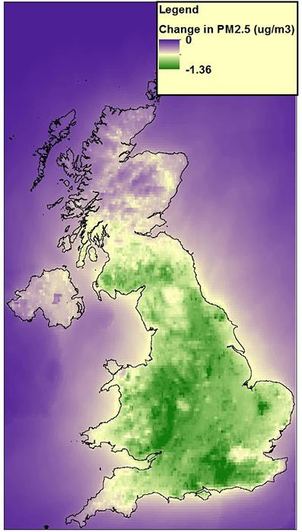


EMEP outputs – national run, all vegetation
6
Change in exposure to PM_{2.5} (µg/m )
Avg: -0.55 (-10%)
Quantity of PM_{2.5} removed (mg/m²)
3
Base map, 2015
No vegetation scenario
Difference map

Slide 7
Physical account- national scale
7
Quantities of pollutant removed (kt/yr)
 |  | Habitat | Coniferous woodland | Deciduous woodland | Semi-natural (grassland, moorland) | Crops | Total vegetation
 |  | Area CEH landcover (km²) | 15,361 | 13,950 | 135,909 | 63,161 | 228,381
 |  | PM₁₀ | 21.3 | 14 | 7.7 | 0 | 43
 |  | PM2.5 | 9.6 | 8.2 | 4.5 | -0.1 | 22.2
 |  | SO₂ | 4 | 7.1 | 17.7 | 9.5 | 38.3
 |  | NH₃ | 4.7 | 8.4 | 26.5 | 7.8 | 47.4
 |  | NO₂ | 1.6 | 2.6 | 10.4 | 9.1 | 23.7
 |  | O₃ | 121.6 | 95.5 | 597.1 | 383.9 | 1198.2

Slide 8
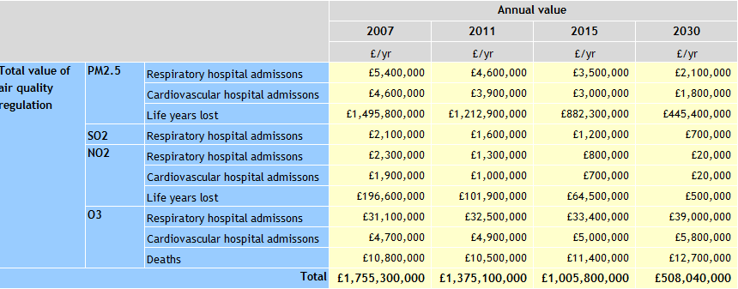
Monetary account - national
8
Annual value of health benefits
8

Slide 9
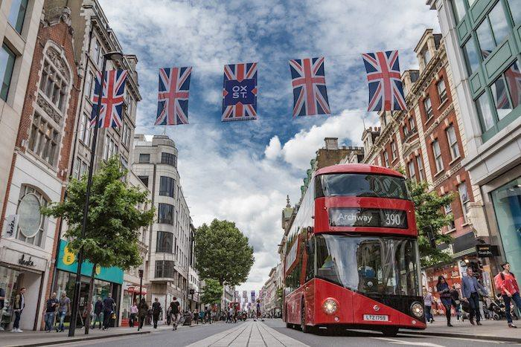
Urban results
9

Slide 10
Urban natural capital
10
Amount of pollutant removed & health outcomes:
 | Habitat | 2015
All pollutants | Urban woodland | 38.2
 | Urban grassland | 4.9
 | Urban fresh/saltwater | 0.1
 | Total urban natural capital | 43.2
Pollutant removed (ktonnes)
 | Health outcome | No/yr
All pollutants combined | Respiratory hospital admissions | -538
 | Cardiovascular hospital admissions | -182
 | Life years lost | -5,899
 | Deaths | -105
Health outcomes

Slide 11
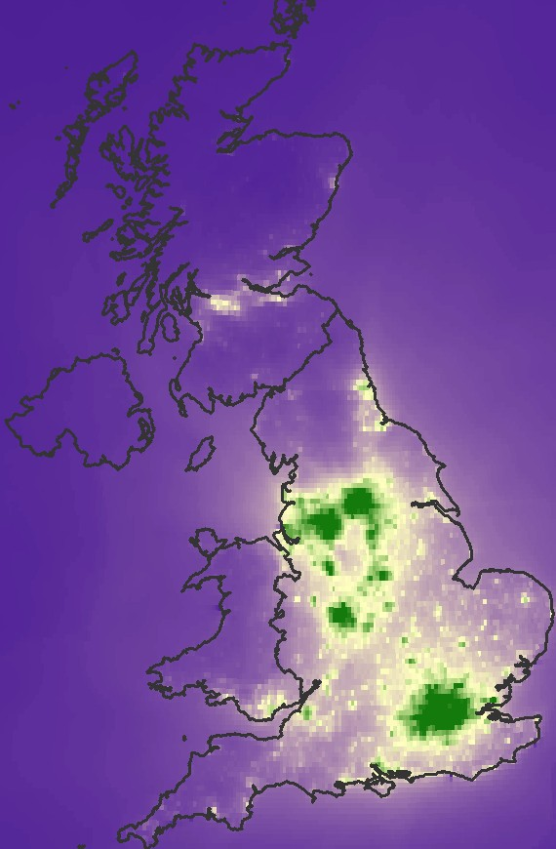
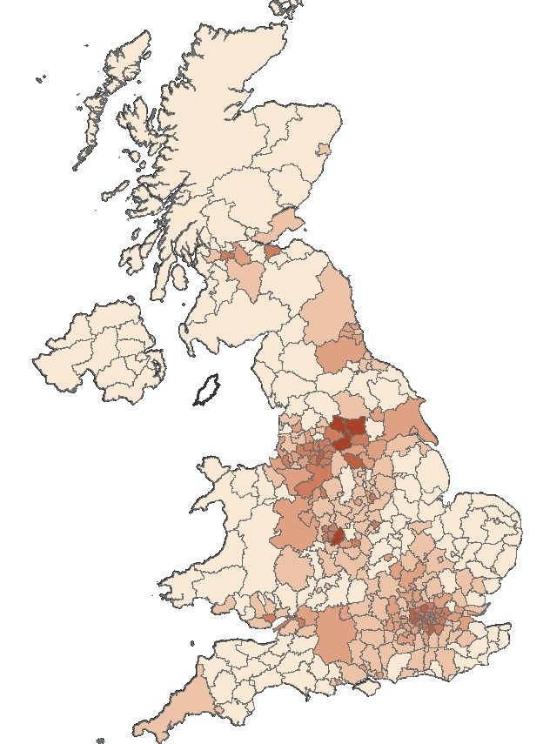

EMEP model outputs – urban natural capital
11
Change in exposure to PM2.5
(ug/m3) Ave: -0.06 (-1%)
Total value of health outcomes =
£200m

Slide 12

Summary
12
Approach is based on realistic chemical interactions, meteorology and pollutant transport
National account shows substantial benefit (£1bn)
Urban vegetation also provides a substantial service (£200m)
Jones, et al. (2017). Developing Estimates for
Contact: Laurence Jones
the Valuation of Air Pollution Removal in Ecosystem Accounts. Final report for Office of National Statistics.
LJ@ceh.ac.uk

Slide 13
EXTRA SLIDES

Slide 14

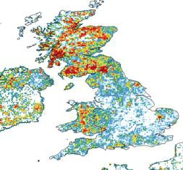
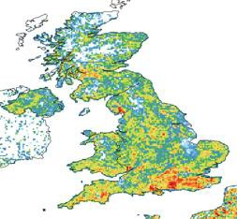
Where is the PM_{2.5} being removed ?
PM2.5 removal (mg/m2)
Proportion of woodland in the landscape
Coniferous woodland
Deciduous woodland

